Slide 1
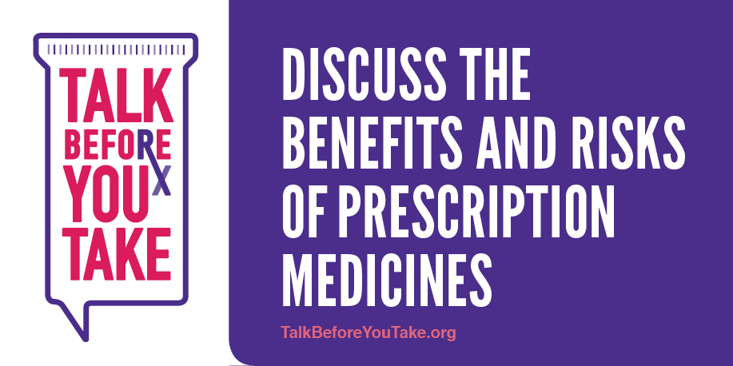
Community Education Promoting Informed Medicine Use

Slide 2
Talk about the benefits and risks of prescribed medications…
…before a prescription is written and filled.
Discussion Today:
Benefits & challenges of good medicine communications
Gaps in patient/healthcare provider communications
4 key tips & 10 questions to ask about your medicines
Tools and Resources
2

Slide 3
Clarity Can Be Hard to Achieve (on the first go-round)
When healthcare providers convey important information about prescribed medications, there is no guarantee that patients fully understand both the benefits and potential risks of starting the treatment.
How often do we walk out of a doctor’s office asking, “What did the doctor or nurse say again about this medicine?”
3

Slide 5
Enhanced Medicine Communications: Benefits
Increasing communications can help patients:
Understand medication side effects—for example, which ones, if any, will go away with time and those that may be experienced for the duration of being on the medicine.
Avoid adverse drug reactions.
Improve adherence to medicine regimen(s).
Live healthier lives.
5

Slide 6
What we know about the communications gaps between patients and their healthcare providers
6

Slide 7
Lack of Medicine Communications Can Have Negative Health Consequences*
High Rx Use
Nearly half of Americans take prescription medicines, and more than 20 percent of Americans take at least three.
However, a research survey of 2,000 adults found that only 56 percent of patients report high to very high adherence to medication regimens (i.e., taking their medication regularly, as prescribed); and
Approximately 62 percent of patients were not aware of any safety warnings about their medicines.
In fact, ten percent of patients unaware of the possibility of a severe side effect actually experience a serious reaction.
Medicines not taken as prescribed
Lack of medicine communic-ation
Serious reactions
* 2014 survey of 2,000 consumers conducted for the BeMedWise Program at NeedyMeds, formerly known as the National Council of Patient Information and Educa-tion (NCPIE), by Ipsos Healthcare with input from the FDA and the Center for Drug Safety and Effectiveness (CDSE), Johns Hopkins Bloomberg School of Public Health
Notes:
Notes: see fuller description of consumer survey in February 2015 “Talk Before You Take” press release from the BeMedWise Program at NeedyMeds, formerly known as the National Council of Patient Information and Education:
http://www.talkaboutrx.org/documents/TalkBeforeYouTakeRelease.pdf

Slide 8
Lack of Medicine Communications Can Have Negative Economic Consequences
Not taking medicines as prescribed
Lack of medicine communication
Higher healthcare costs
The cycle of medication non-adherence and lack of effective patient-healthcare provider communication about medications has long-term implications, contributing to as much as $290 billion per year in avoidable medical spending or 13 percent of total healthcare expenditures*.
*New England Healthcare Institute Research Brief: Thinking outside the pillbox: a system-wide approach to improving patient medication adherence for chronic disease. August 2009.
8
Notes:
Poor adherence leads to poor health outcomes; Poor adherence also leads to increased medical costs
NEHI Research Brief: http://www.nehi.net/writable/publication_files/file/pa_issue_brief_final.pdf

Slide 9
Addressing the Gaps: Engaging in Conversation & Asking the Right Questions
9

Slide 10
Empowering Conversations
Promoting Dialogue
Encouraging Questions
Ensuring Clarity
10
Notes:
The goals of Talk Before You Take

Slide 11
Addressing the Gaps with Engagement & Conversation
The Talk Before You Take campaign addresses communications gaps and encourages informed patient and healthcare provider engagement and conversation about medicine uses, anticipated benefits and potential risks.
The research and campaign were developed through a grant provided by the U.S. Food and Drug Administration's (FDA) Center for Drug Evaluation and Research.
*This work was supported by the U.S. Food and Drug Administration, Center for Drug Evaluation and Research under grant number 5U18FD004653-03. The content is solely the responsibility of BeMedWise and does not necessarily represent the official views of the Food and Drug Administration.
11

Slide 12
Talk Before You Take: 4 Key Tips
Four important tips for patients and caregivers to guide conversations with healthcare providers:
Talk to your healthcare provider and ask questions about the benefits and potential risks of prescription medicines you take.
Tell your healthcare provider about all of the medicines you are taking — including OTC medicines, vitamins, and dietary supplements.
Tell your healthcare provider about any allergies or sensitivities that you may have.
Read and follow the medicine label and directions.
12

Slide 13
Talk Before You Take: 10 Key Questions to Ask
What’s the name of the medicine, and what is it for?
How and when do I take it, and for how long?
What side effects should I expect, and what should I do about them?
Should I take this medicine on an empty stomach or with food?
Should I avoid any activities, foods, drinks, alcohol, or other medicines while taking this prescription?
13

Slide 14
10 Key Questions to Ask, continued
If it’s a once-a-day dose, is it best to take it in the morning or evening?
Will this medicine work safely with other medicines I’m taking, including over-the-counter-medicines?
When should I expect the medicine to begin to work, and how will I know if it’s working?
How should I store it?
Is there any additional written information I should read about the medicine?
14

Slide 15
Additional
Resources
Downloadable
“Pocket Guide” of Tips & Questions
Videos
Posters
Resources for consumers & healthcare professionals
TalkBeforeYouTake.org
15

